Slide 1

Vel Tech Rangarajan Dr. Sagunthala R&D Institute of Science and Technology
School of Computing
Department of Computer Science and Engineering
10211CS224 / FULL STACK APPLICATION DEVELOPMENT (JAVA)
END SEMESTER PROJECT REVIEW
Date: 06-05-2026
Design and develop a React JS based web application for Ticket Booking of an Internal Department Event
SDG: 9 – Industry , Innovation and Infrastructure
Presented By:
KISHORE S – VTU24452 – 23UECS0769
Courses Handling Faculty:
Dr. HAFIZUR RAHMAN
ASSISTANT PROFESSOR

Slide 2
INTRODUCTION
Background of the Problem
Many colleges and organizations still rely on manual or semi-digital methods (like spreadsheets, paper registrations, or Google Forms) for event ticket booking. This leads to issues such as duplicate entries, lack of real-time updates, difficulty in managing seat availability, and poor user experience.
Importance of the Project
The Ticket Booking System provides a centralized and efficient platform for managing internal department events. It simplifies the booking process by offering real-time seat availability, secure registration, and easy data management. This system reduces manual effort, avoids booking conflicts, and improves overall event organization.
Real-World Relevance
In today’s digital era, automated ticket booking systems are widely used for events, movies, transportation, and seminars. Implementing such a system helps students and organizers understand real-world application development and prepares them for building scalable solutions used in industries.
System Overview
The Ticket Booking System is a web-based application built using React JS for a dynamic and responsive frontend.
1
2
3
4
5
6
7
8
9

Slide 3
PROBLEM STATEMENT
1
Problem Statement
Managing ticket bookings for internal department events such as technical fests, workshops, and seminars is often inefficient due to manual processes or poorly organized digital tools.
These methods lack real-time updates, can lead to overbooking or data inconsistencies, and make it difficult for organizers to track participants and manage event capacity effectively.
There is a need for a centralized, user-friendly web application that allows users to book tickets seamlessly while enabling administrators to manage events, monitor registrations, and ensure accurate, real-time data handling.
The system should provide a smooth booking experience, reduce manual errors, and improve overall event management efficiency.
Additionally, the absence of a structured system makes it difficult to generate reports and analyze event participation trends.
A digital solution is required to ensure transparency, improve accessibility, and enhance the overall user experience for both organizers and participants.
2
3
4
5
6
7
8
9

Slide 4
OBJECTIVE(S)
1
Objectives
To develop a user-friendly web application that enables easy and secure ticket booking for internal department events.
To provide an efficient system for organizers to manage events, track registrations, and monitor seat availability in real-time.
2
3
4
5
6
7
8
9

Slide 5
PROPOSED SYSTEM
1
Proposed Solution
Provides a simple and intuitive UI for users to browse events and book tickets easily. Improves user experience with clean navigation and design.
Allows users to explore upcoming events / seminar in the portal
Enables user to register for the events by giving their details and selecting their preferred seats.
After this moves to the confirmation state where user enter their card details for payment .
Automatically confirms ticket bookings after successful transactions. Reduces manual work and improves system efficiency.
Generates tickets along with a pdf (optional) allows reducing difficulties at time of participation.
2
3
4
5
6
7
8
9

Slide 6
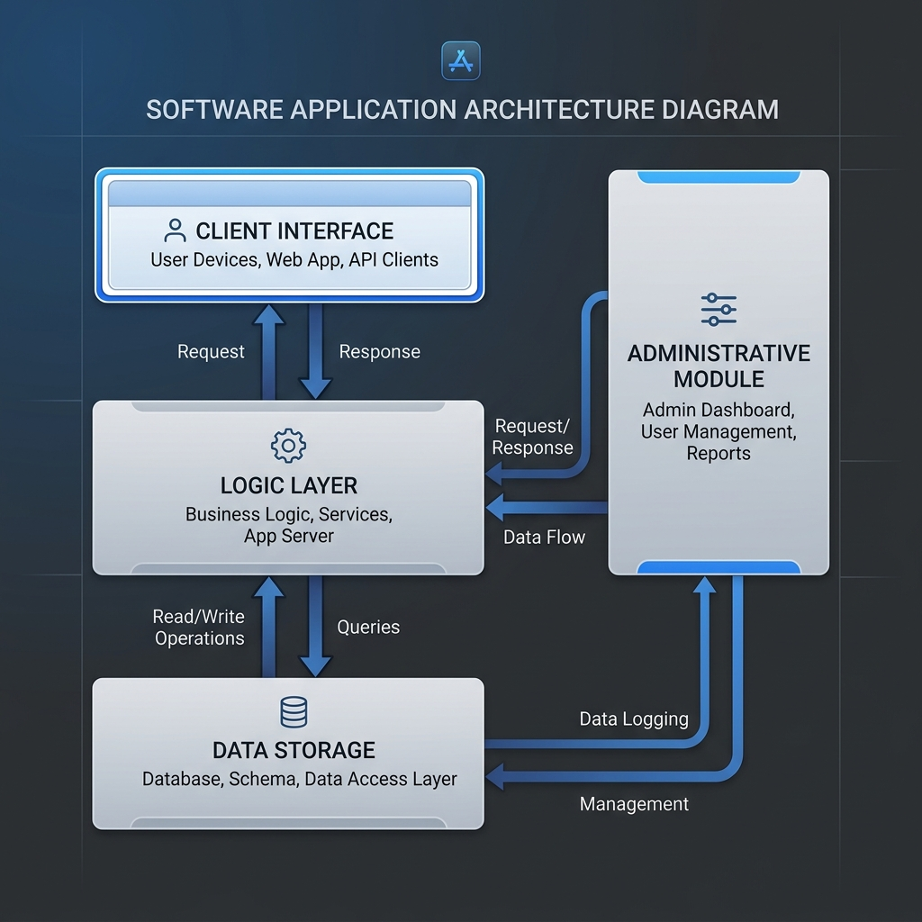
PROPOSED SYSTEM ARCHITECTURE
Input
The system takes user inputs such as name, email ID, department, and number of tickets required.It also accepts event-related data like event name, date, venue, and ticket price for processing bookings.
Processing
The system validates user inputs and checks ticket availability before processing the booking request. It then updates the database, reduces the available ticket count, and generates a booking confirmation.
Payment Gateway
Allows the user to do payment and after payment is done it redirects to the confirmation page.
​
Output ​
​The system displays booking confirmation along with user details, event name, number of tickets, and total amount with a pdf .
1
2
3
4
5
6
7
8
9

Slide 7
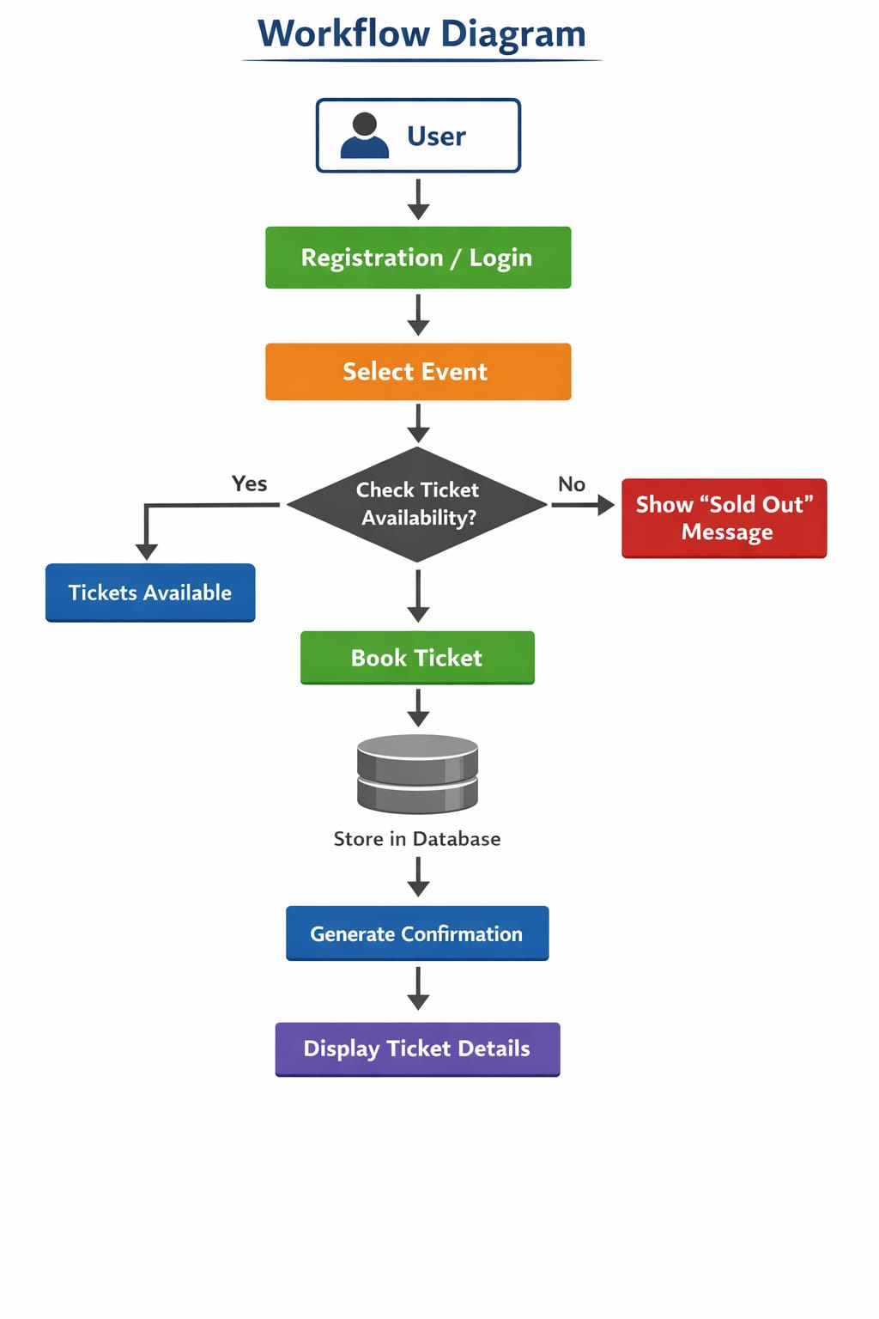
WORKFLOW
1
2
3
4
5
6
7
8
9

Slide 8
TECHNOLOGIES USED
Frontend:
HTML5
Javascript
CSS3
React JS
Backend:
LocalStorage
Data Base / Tools:
VS Code
Notepad++
Software Requirements:
Processor: Intel i3 or above RAM: 4GB minimum Operating System: Windows / Linux / macOS Web Browser: Chrome / Edge / Firefox / Safari
1
2
3
4
5
6
7
8
9

Slide 9
MODULE DESCRIPTION
1
Module 1: User Management
Handles user registration, login, and profile management with secure authentication.
Module 2: Event Management
Allows admin to create, update, and delete events and manage event details.
Module 3: Ticket Booking System
Enables users to view events, select tickets, and complete the booking process.
Module 4: Payment and Confirmation
Generates booking confirmation and allows users to receive tickets.
Module 4:Notification Module
A small notification in user login showing the booked tickets.
2
3
4
5
6
7
8
9

Slide 10
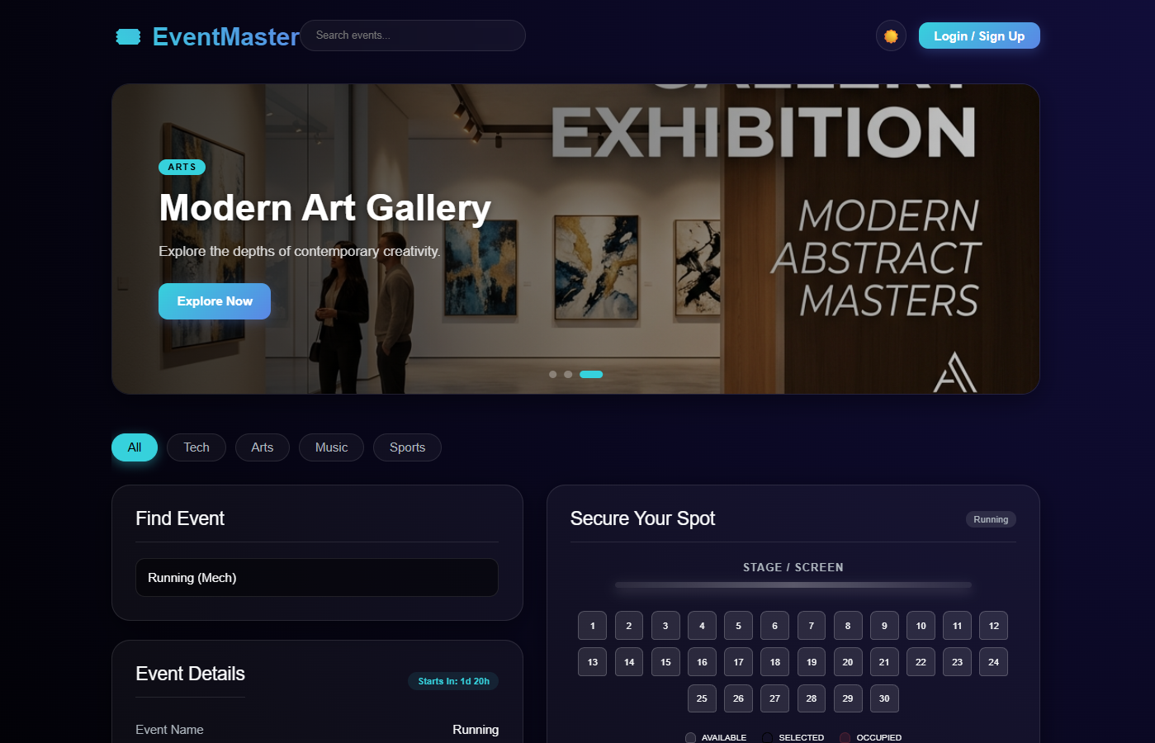
IMPLEMENTATION SCREENSHOTS
1
2
3
4
5
6
7
8(A)
9
The screenshot shows the user interface of the Ticket Booking System with event details and booking form displayed clearly.

Slide 11
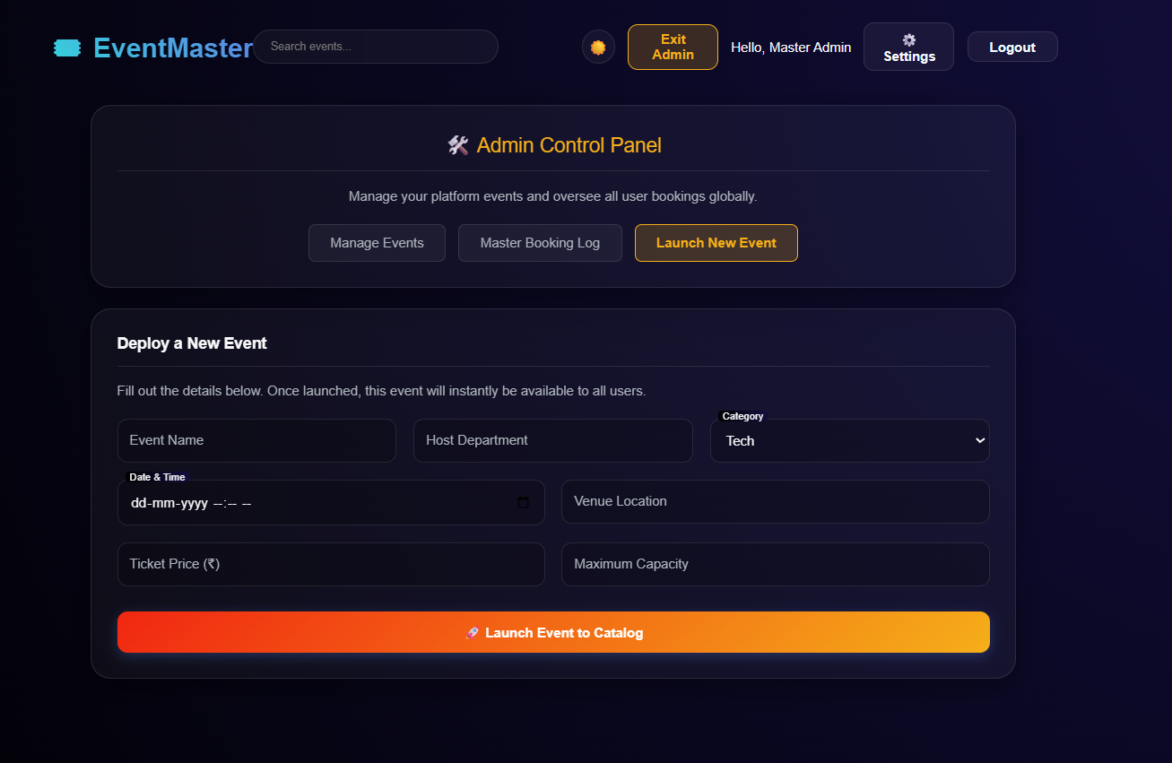
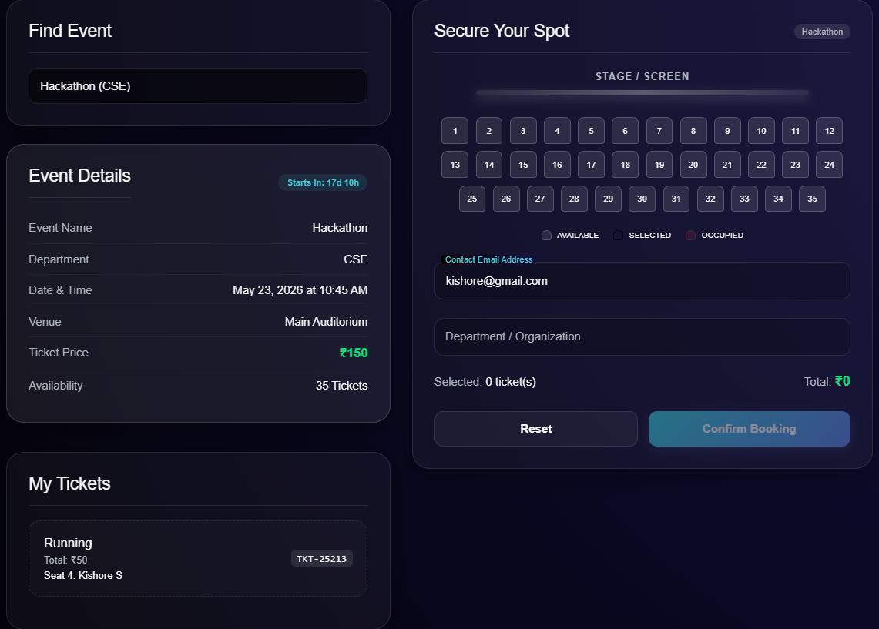
IMPLEMENTATION SCREENSHOTS
Admin Login Page
User Login Page
1
2
3
4
5
6
7
8(B)
9

Slide 12
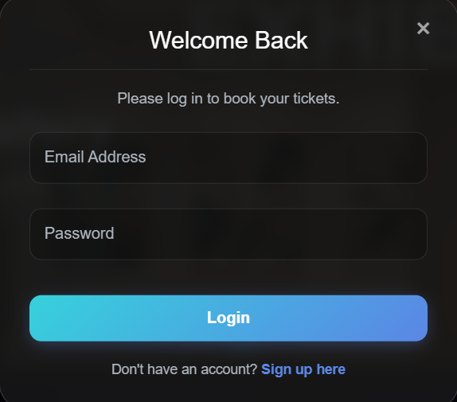
IMPLEMENTATION SCREENSHOTS
1
2
3
4
5
6
7
8(C)
9
This allows to login / register to access the website fully like registering for event .

Slide 13
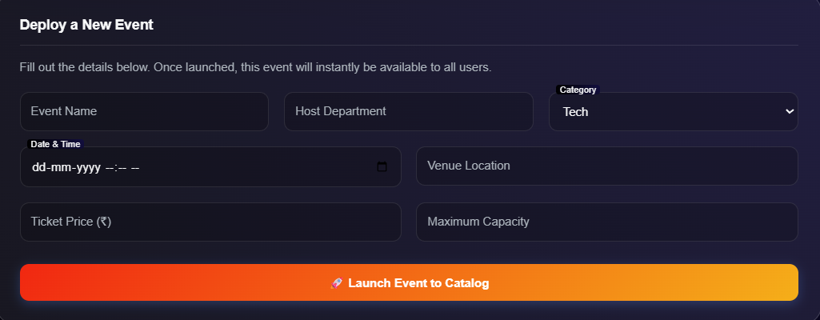
IMPLEMENTATION SCREENSHOTS
1
2
3
4
5
6
7
8(D)
9
This is admin panel where admin can create new events , update the details and delete the existing events in the database .

Slide 14
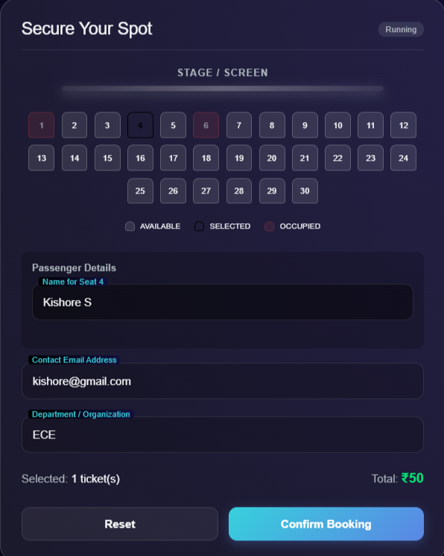
IMPLEMENTATION SCREENSHOTS
1
2
3
4
5
6
7
8(E)
9
This is user login where the student can select seats and register for the events by giving their details .

Slide 15
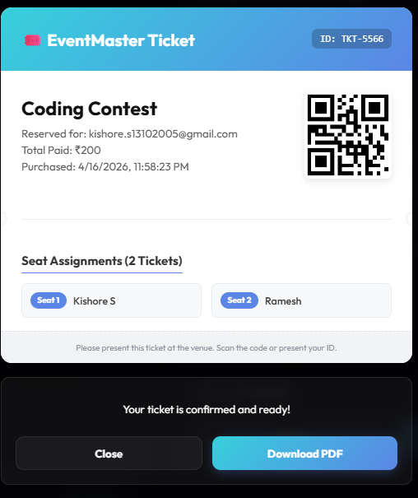
IMPLEMENTATION SCREENSHOTS
1
2
3
4
5
6
7
8(F)
9
This screenshot shows the booking confirmation section with user details, event name, number of tickets, and total amount.

Slide 16
ADVANTAGES & LIMITATIONS
1
ADVANTAGES
Simple and user-friendly interface helps students and faculty book tickets quickly without confusion.
Automatically updates available ticket count, reducing chances of overbooking.
Eliminates paperwork and manual tracking, saving time for organizers.
LIMITATIONS
Designed mainly for internal department events, not suitable for large-scale systems.
Basic version may not support payment gateways for real transactions.
2
3
4
5
6
7
8
9

Slide 17
Thank you

